Slide 1
British Airways Customer Review Data Scraping And Visualization
By
Adedayo Abiodun Adeboye

Slide 2
British Airways
Customer Experience
Review
British Airways Review Parameters
Relevance
Enquiry
To ensure service stability and improvement, an organization should review the customer experience on a regular basis. Customer experience encompasses cognitive, affective, sensory, and behavioral responses across all stages of the consumption process, including pre-purchase, consumption, and post-purchase. Airline companies cannot be left out of this process, as they should review their customers' experiences from the initialization stage until the terminal stage to secure loyalty and to encourage future business relationships
Awareness
Consideration
Sales Encounter
The Prospect Experience
LOUNGE
Records
Lost Customer
Inflight Entertainment
Seat Comfort
AIRLINE
DECISION
Lapsed Customer
Food & Beverages
Staff Service
Order

Slide 3
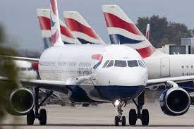
In recent years, airlines have become a popular mode of transportation, which has increased competition. As a result of this intense competition, airline companies strive to gain a competitive advantage by providing the best possible service. This is done by understanding and solving customer complaints about airline transportation.
In this situation, customer experience reviews should be viewed as a performance evaluation indicator. In order to prevent customer loss, a business must identify and resolve failures as well as problems with its services. It is important to understand reviews and to resolve difficulties as quickly as possible.
The purpose of this project is to employ data analysis tools in order to extract customer review data, clean it, visualize and extract useful insights to foster business growth enhance profitability and prevent negative word-of-mouth communication about British Airways.
Executive Summary

Slide 4
METHODOLOGY
Data Scraping From Skytrax API
Data Cleaning and Preparation
Exploratory Data Analysis
Visualization
Make a purchase on your website
Generating Useful Insights
Conclusion & Prescription

Slide 5
Data Scraping From Skytrax
Seat Type
Rating Count
Type of Traveler
Route
Value for money
Country
Review head
Review Details
Date

Slide 6
Canada
Economy Class
Canada
Country, Traveler type, Seat type & Value-for-money Count When stars is 1
Australia
Australia
United State
United Kingdom
Canada
Australia
Iceland
856
457
98
51
44
Solo Leisure
Couple Leisure
Family Leisure
Business
608
583
416
230
Economy Class
Business Class
Premium Economy
1126
579
132
No
Yes
1508
329

Slide 7
Canada
Economy Class
Canada
Country, Traveler type, Seat type & Value-for-money Count When stars is 10
Australia
Australia
United State
United Kingdom
Canada
Australia
Iceland
105
52
10
5
5
Solo Leisure
Couple Leisure
Family Leisure
Business
64
79
44
25
Economy Class
Business Class
Premium Economy
126
73
13
No
Yes
178
34

Slide 8
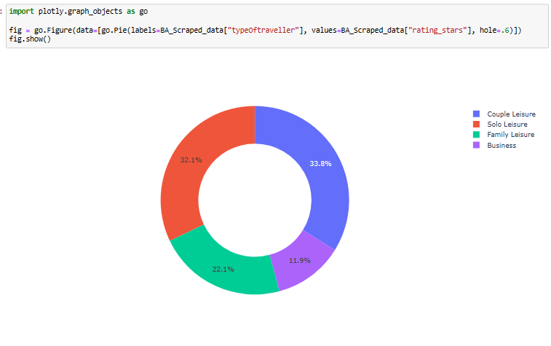
Type of traveler vs Rating stars
Couple Leisure had the highest rating stars at 3403, followed by Solo Leisure, Family Leisure, and Business. Couple Leisure accounted for 33.03% of rating stars.

Slide 9
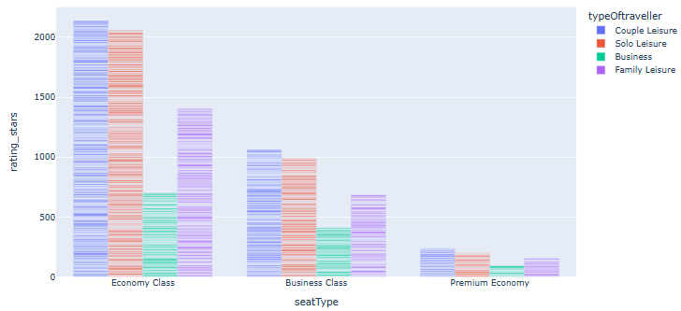
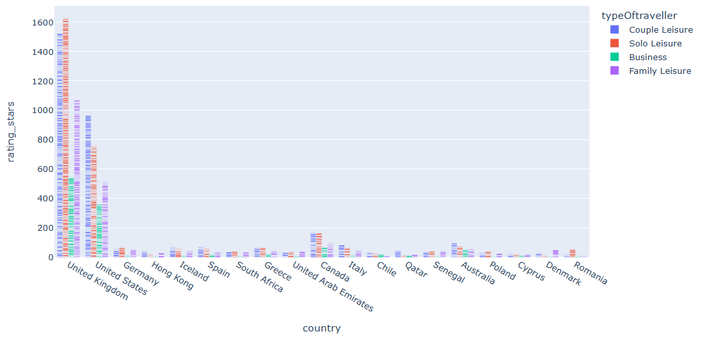
Rating Elements
At 5854 approximate, Economy Class had the highest rating stars and was 722.19% higher than Premium Economy, which had the lowest rating stars at 712. Economy Class had the highest rating stars at 5854, followed by Business Class at 3199 and Premium Economy at 712. Economy Class accounted for 59.95% of rating stars. Economy Class had 5854 rating stars, Premium Economy had 712, and Business Class had 3199
At 4473, United Kingdom had the highest rating stars and was 5,101.16% higher than Cyprus, which had the lowest rating stars at 86. United Kingdom had the highest rating stars at 4473, followed by United States and Canada. Cyprus had the lowest rating stars at 86. United Kingdom accounted for 45.81% of rating stars. Across all 18 country, rating stars ranged from 86 to 4473.

Slide 10
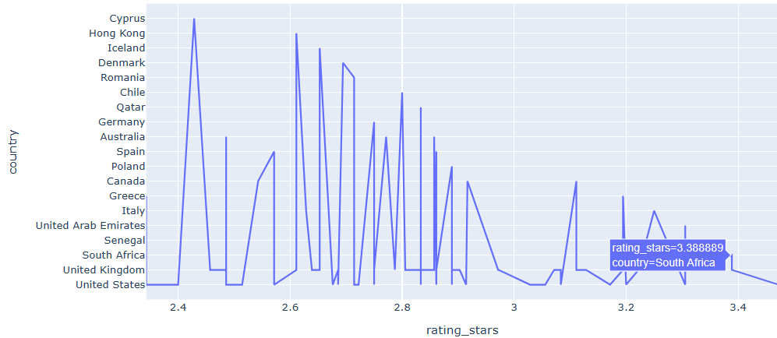
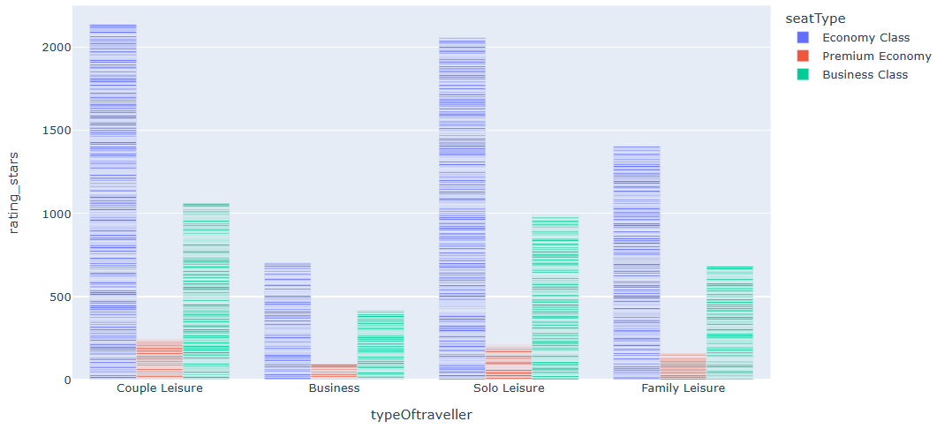
Rating Elements
At 3.39, South Africa had the highest Average of rating stars and was 41.86% higher than Cyprus, which had
the lowest Average of rating stars at 2.39.
South Africa had the highest Average of rating stars at 3.39. Cyprus had the lowest Average of rating stars at
2.39.
Across all 17 country, Average of rating stars ranged from 2.39 to 3.39.
At 3403, Couple Leisure had the highest rating stars and was 203.03% higher than Business, which
had the lowest rating stars at 1123.
Couple Leisure had the highest rating stars at 3403, followed by Solo Leisure, Family Leisure, and
Business.
Couple Leisure accounted for 34.85% of rating stars.
Across all 4 type of traveler, rating stars ranged from 1123 to 3403.

Slide 11
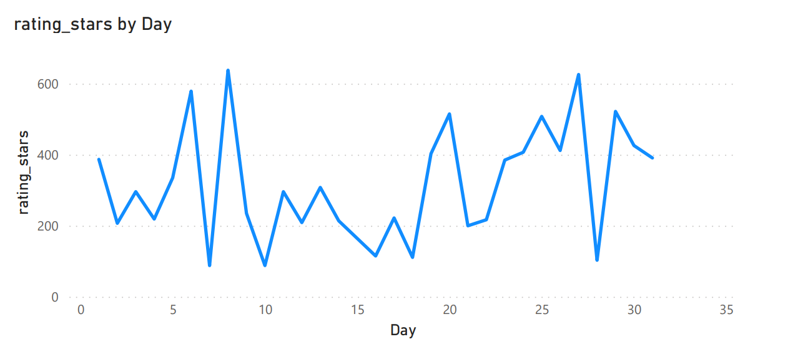
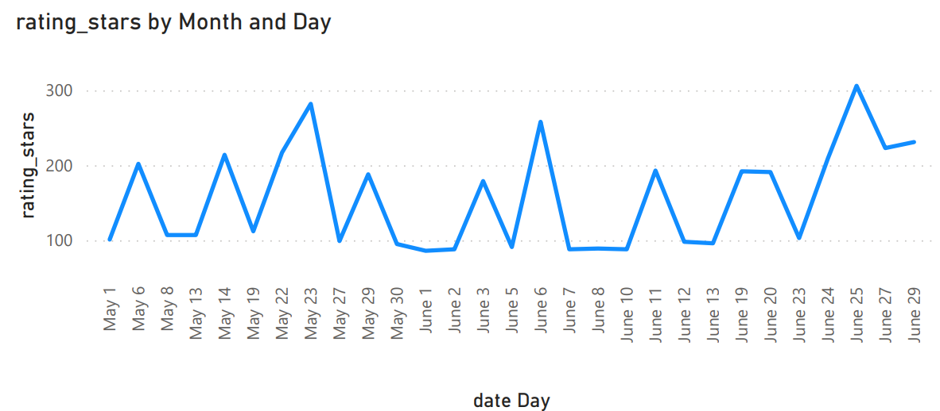
Time Series Analysis and Insights
8 had the highest total rating stars at 638, followed by 27 and 6. 2 had the lowest total
Rating stars at 207.
July in Day 20 made up 3.35% of rating stars.
20 had the highest average rating stars at 257.50, followed by 27 and 26. 1 had the lowest
average rating stars at 96.75.
Rating stars trended up, resulting in a 1.03% increase between Sunday, January 1, 2023 and
Tuesday, January 31, 2023.
Rating stars started trending up on Sunday, January 1, 2023, rising by 1.03% (4) in 30 days.
Rating stars jumped from 387 to 391 during its steepest incline between Sunday, January 1, 2023
and Tuesday, January 31, 2023.

Slide 12
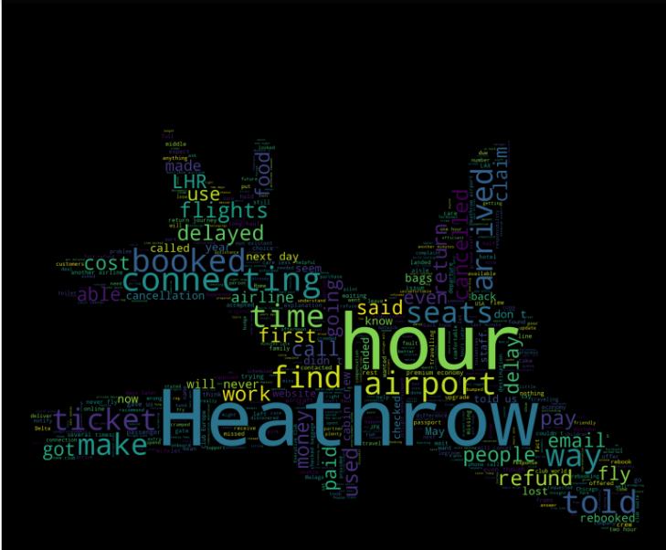
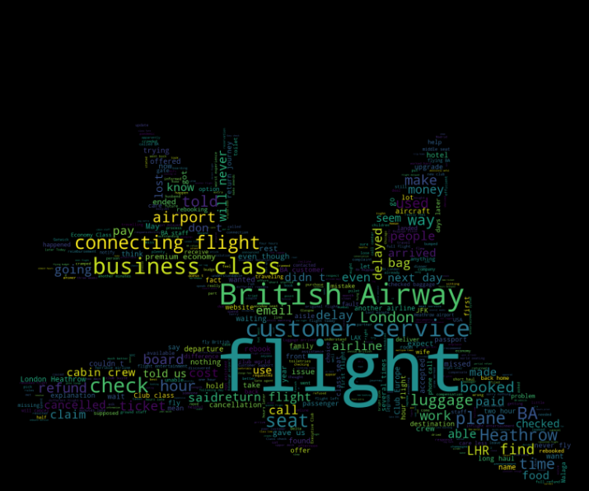
WordCloud Visualization
WordCloud visualization to show words that are frequency used. The following word: seat, flight, British, Airway, Airways, check, luggage, bag, board, London, busines, class, book, plane, BA, customer, service were ignored in the second wordcloud analysis to achieved the second wordcloud
Here we observe the second visualized which words dominate customers experience base on individual experiences

Slide 13
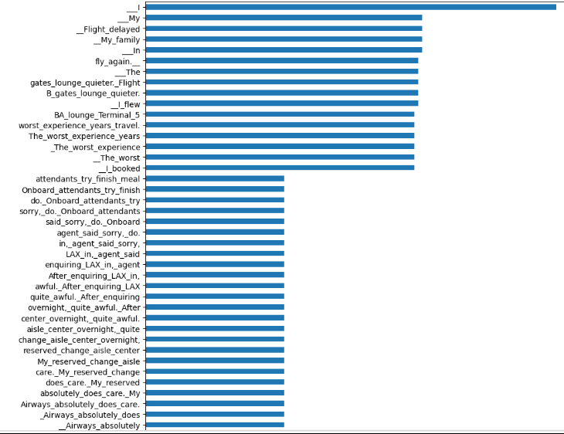
Frequency distribution of customer comments

Slide 14
Measure the real business impact across the customer journey through customer service performance index
Customer
services improvement
Improving the customer type travel experience to get value for their money
Couple Leisure need to be monitor for optimization
Seat Type need Improvement for Customer to have value for their money
Seat need Improvement for
Cyprus average rating fall below average
Customer Experience Optimization
Understanding time factors and impact on customer satisfaction is instrumental in improving customer experience in the time of their journey
Address root cause issues that are impacting the customer from Cyprus fall below average
Time Elements
As we notice from wordcloud, flight delay are among the dissatisfaction customer are pressed with. Time efficiency need to be worked on
Flight time efficiency
Onboard attendance service need improvement
Improve the overnight lounge

